Slide 2
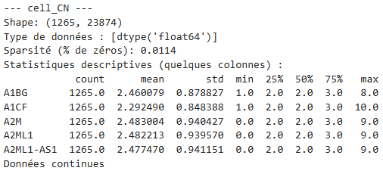
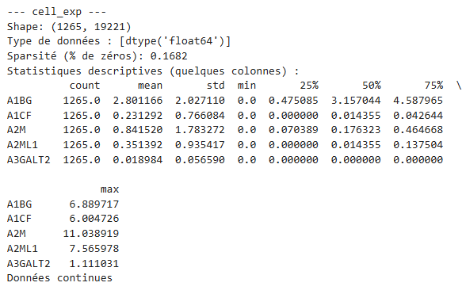
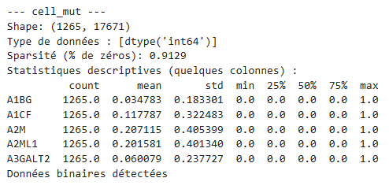








Cell modalities not normalized
COPY NUMBER
NIVEAU D’EXPRESSION
MUTATIONS

Slide 3
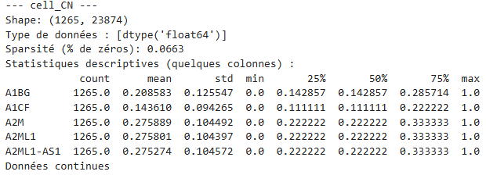
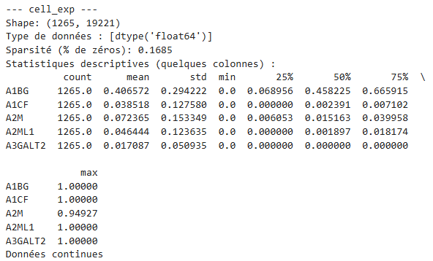
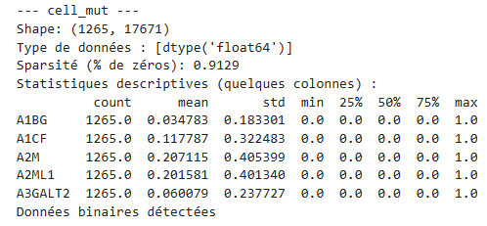








Cell modalities w/ min-max normalization
COPY NUMBER
NIVEAU D’EXPRESSION
MUTATIONS
Min-max normalization do not change binary data

Slide 4
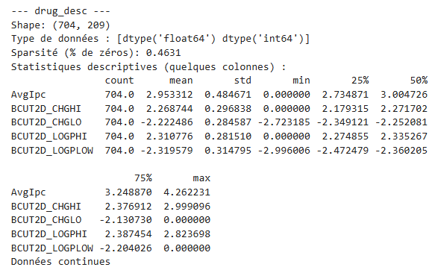
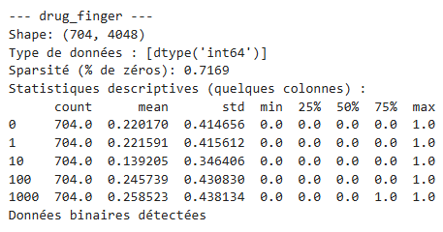
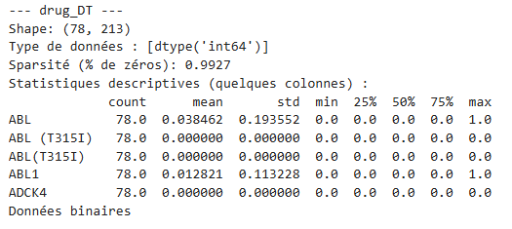
drug modalities not normalized

Slide 5
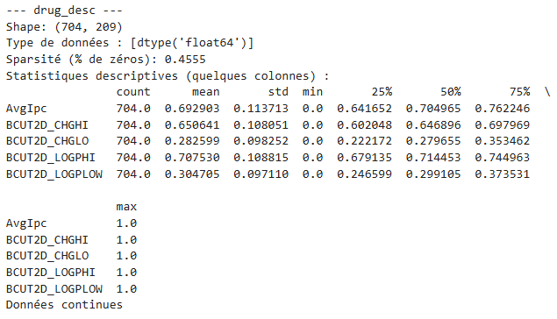
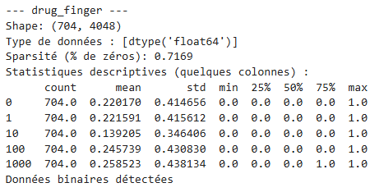
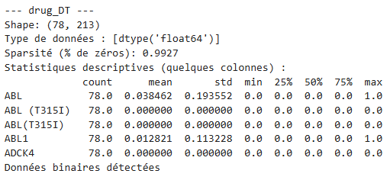
drug modalities w/ min-max normalization
Min-max normalization do not change binary data

Slide 6
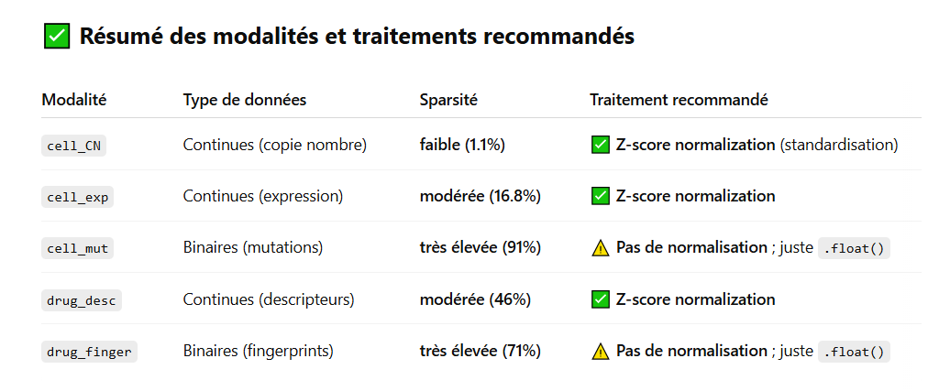

Slide 7
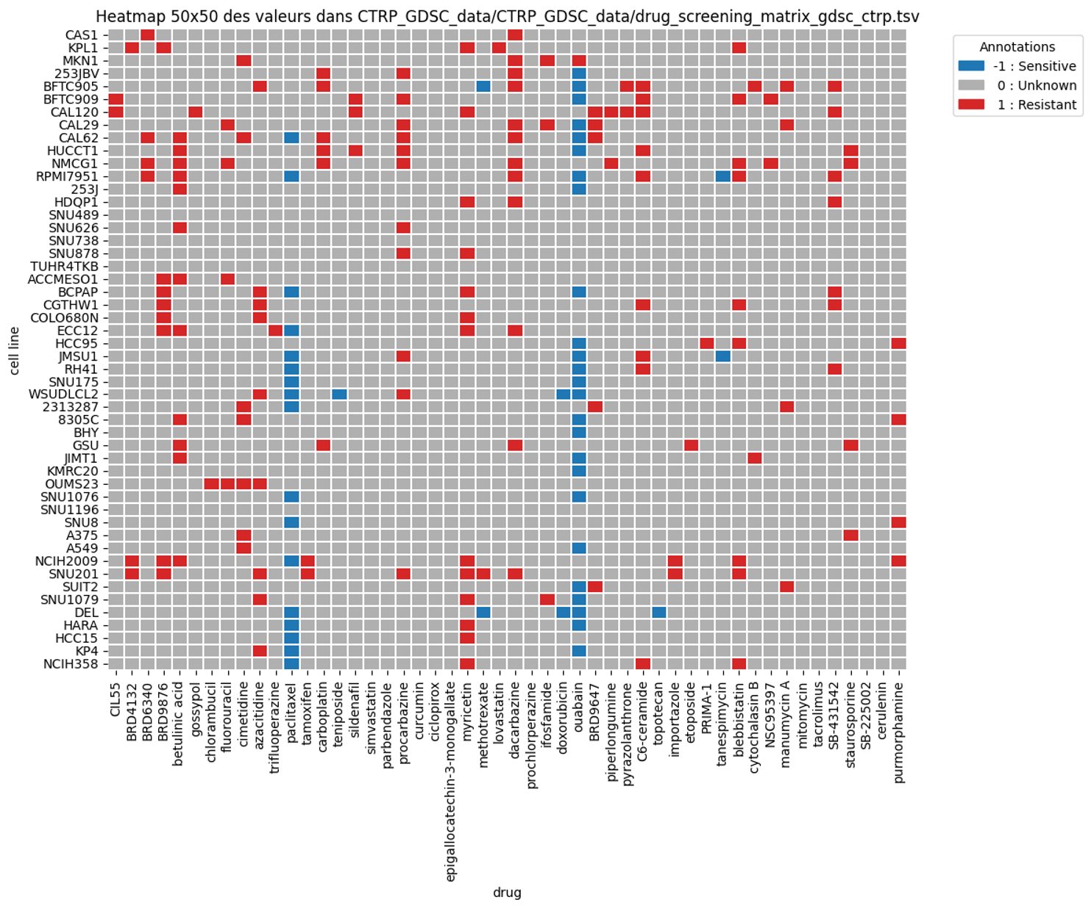
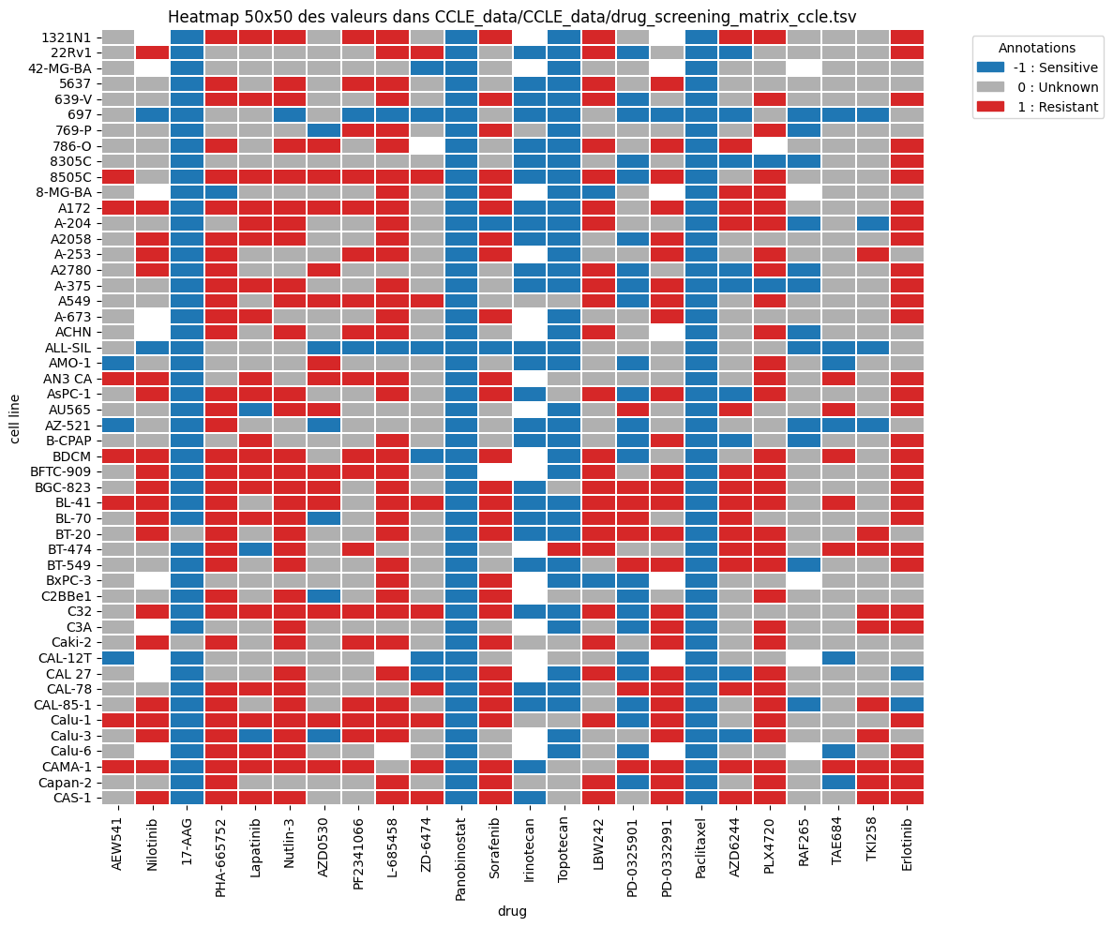
Screening files : labelised data
CTRP-GDSC
CCLE

Slide 8
CTRP-GDSC
CCLE
cell_CN: (1265, 23874)
cell_exp: (1265, 19221)
cell_mut: (1265, 17671)
drug_desc: (704, 209)
drug_finger: (704, 4048)
cell_CN: (1260, 23874)
cell_exp: (1260, 19221)
cell_mut: (1260, 17671)
drug_desc: (704, 209)
drug_finger: (704, 4048)
X_cell sparsity: 0.34482276923373134
X_drug sparsity: 0.7043432474854251
X_cell_test sparsity: 0.3700451615330001
X_drug_test sparsity: 0.7043432474854251

Slide 9
ONLY cell_exp
CTRP-GDSC
all data
CCLE
all data
cell_exp: (1359, 19221)
drug_desc: (704, 209)
drug_finger: (704, 4048)
cell_exp: (1359, 19221)
drug_desc: (704, 209)
drug_finger: (704, 4048)
X_cell sparsity: 0.1692699979890005
X_drug sparsity: 0.7043432474854251
X_cell_test sparsity: 0.1692699979890005
X_drug_test sparsity: 0.7043432474854251

Slide 10
ONLY cell_exp
CTRP-GDSC
Labeled data
CCLE
Labeled data
cell_exp: (373, 19221)
drug_desc: (690, 209)
drug_finger: (690, 4048)
cell_exp: (714, 19221)
drug_desc: (32, 209)
drug_finger: (32, 4048)
X_cell sparsity: 0.1692699979890005
X_drug sparsity: 0.7043432474854251
X_cell_test sparsity: 0.1692699979890005
X_drug_test sparsity: 0.7043432474854251

Slide 11
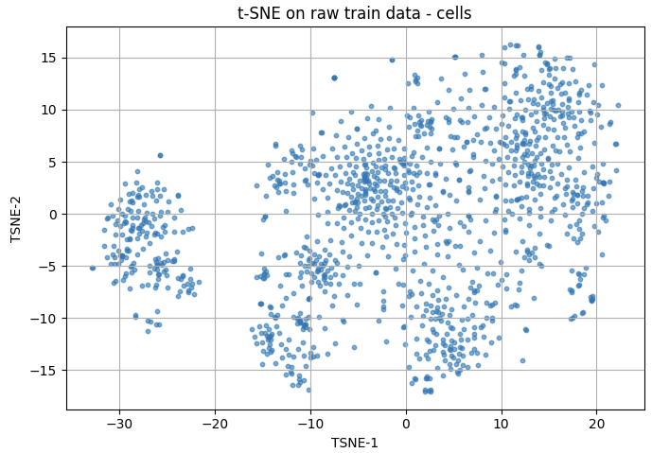
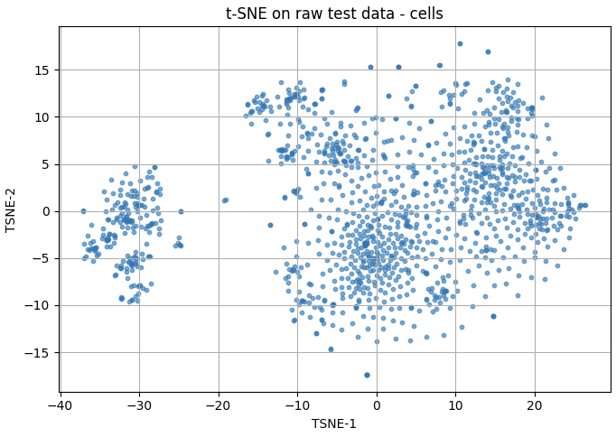
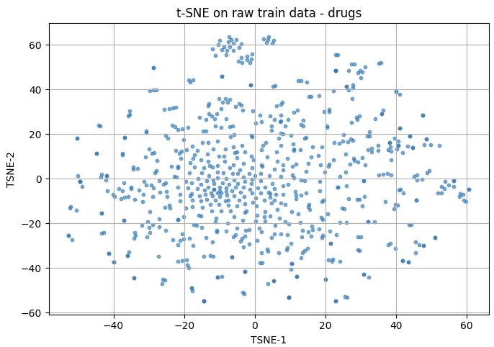
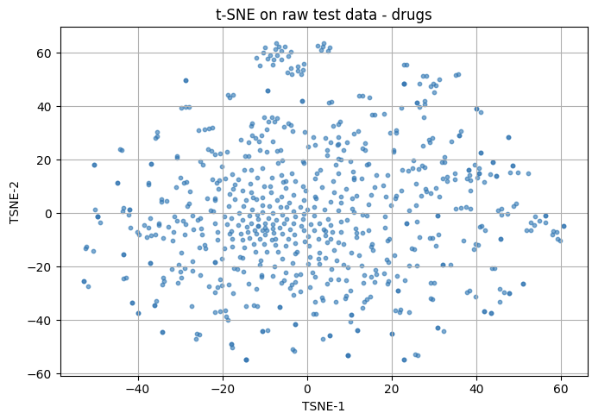
T-SNE INPUT DATA
CTRP-GDSC
CCLE
cells
drugs

Slide 12
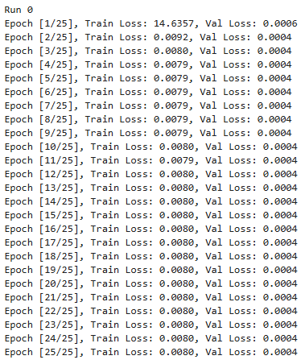
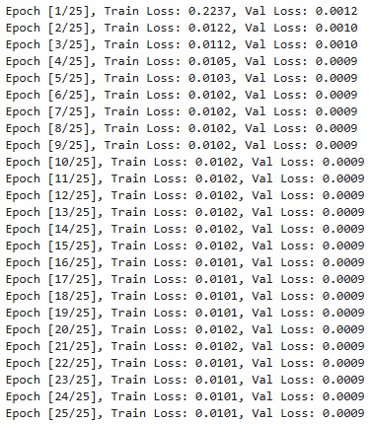
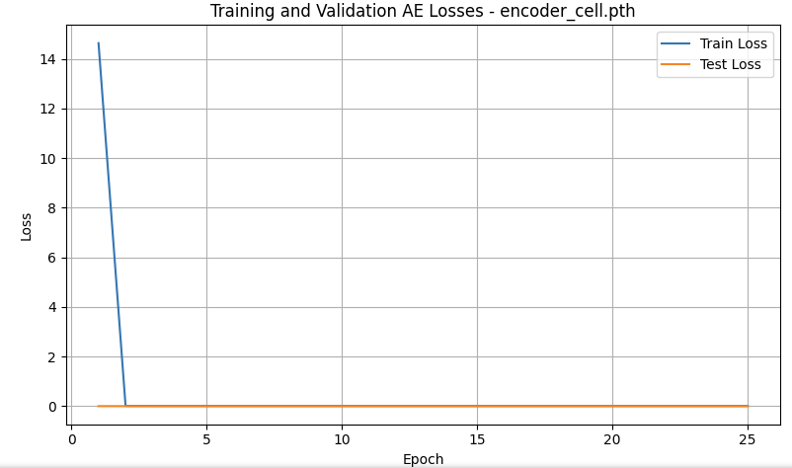
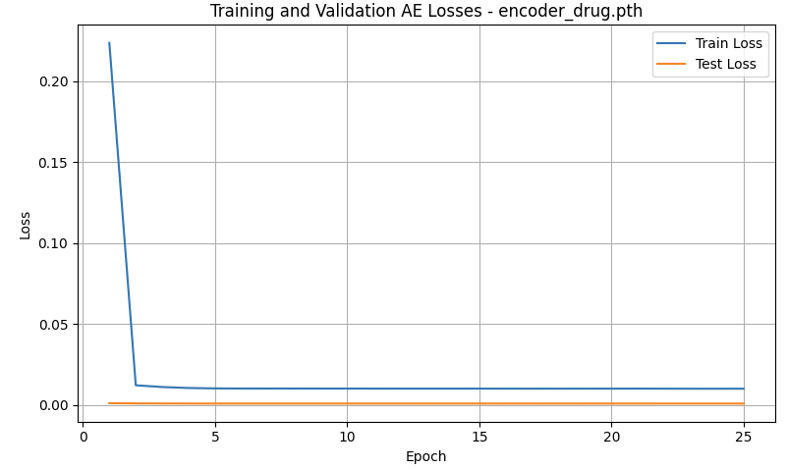
Train : CTRP-GDSC
Test : CCLE
Learning rate = 0.01
MSE
Notes:
Learning rate is a hyperparameter that controls how much the model updates its weights during training after each step of gradient descent.
If the learning rate is too high, the model can lead to faster convergence but risks overshooting the minimum or diverging.
A low learning rate allows for finer adjustments and more stable convergence, but training might be slower.
For AE cells: The training loss drops drastically from 14.6 to ~0.008 in just 2 epochs. However, this is suspiciously fast, which often indicates:
The model may have memorized the training data too quickly.
The latent space might be poorly structured, since learning was too aggressive.
The loss then plateaus very early → potential loss of generalization power.
For AE drugs: Similar pattern — loss quickly drops, then flattens with minimal improvement. Still better than the cell encoder in terms of initial stability, but learning saturates too soon.

Slide 13
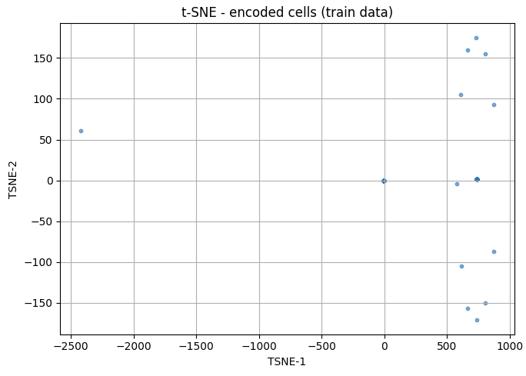
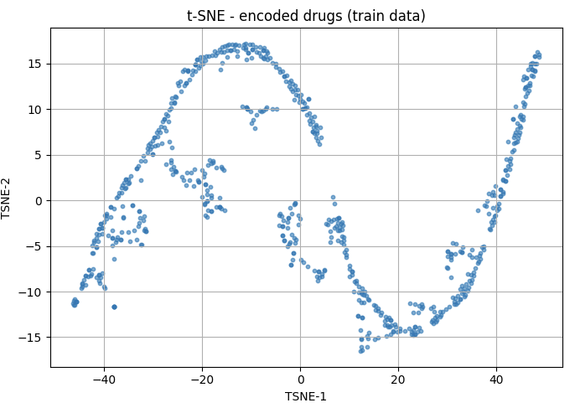
Train : CTRP-GDSC
Test : CCLE
Learning rate = 0.01
MSE
z_cell std: 0.07634297758340836 z_drug std: 0.9282354116439819
Notes:
For AE cells:
The latent space is indeed poorly structured: The t-SNE plot shows sparse and almost collapsed points.
The low std (0.076) confirms that the encoder is outputting nearly the same latent vector for all cell types.
For AE drugs:
Latent space is more structured, but still somewhat curved and rigid.
The std (0.92) is decent.
With high LR, the encoder for cells has likely overfit fast and poorly, leading to a collapsed latent space, despite fast loss drop. The drug AE performs a bit better

Slide 14
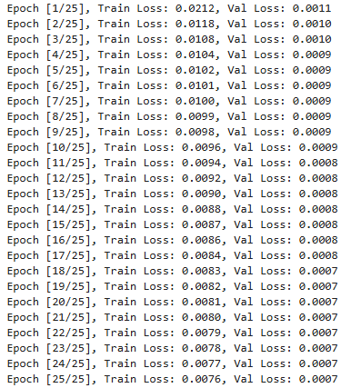
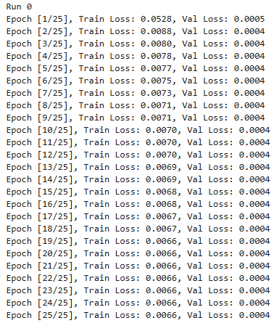
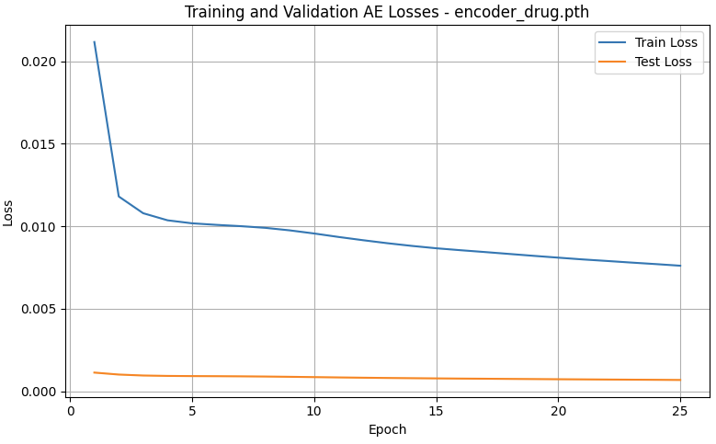
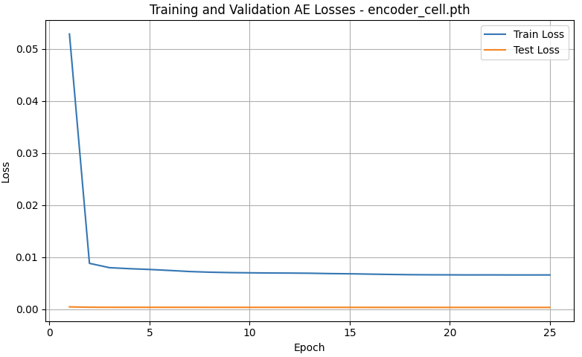
Train : CTRP-GDSC
Test : CCLE
Learning rate = 0.001
MSE
Notes:
lr = 0.001: smaller steps, slower training, but more precise and stable convergence.
For AE cells: The initial loss is lower (around 0.05 instead of 14), and the drop is more progressive and smoother.
This is a sign of better generalization, and the model is learning gradually and more meaningfully.
The latent space is likely better structured, which benefits downstream tasks.
For AE drugs: Same improvement: smoother decrease, no abrupt jumps. Final loss is lower than with lr=0.01.
Curve shows the model is still improving steadily → it’s learning useful features, not just overfitting noise.

Slide 15
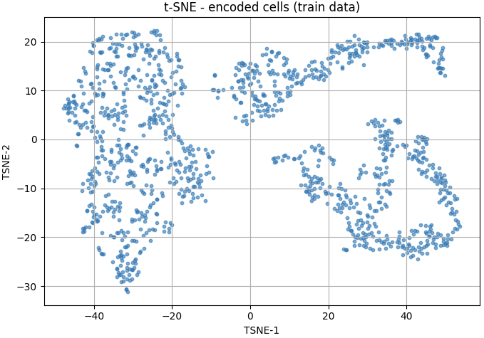
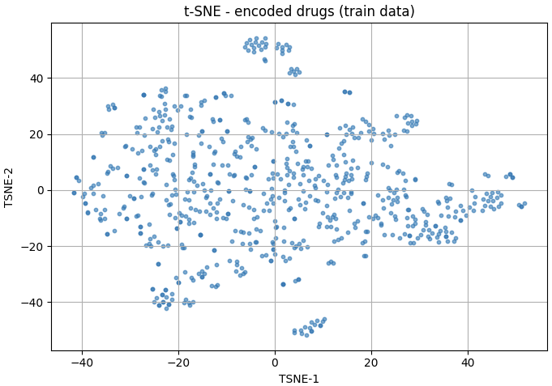
Train : CTRP-GDSC
Test : CCLE
Learning rate = 0.001
MSE
z_cell std: 0.9915185570716858 z_drug std: 1.2932968139648438
Notes:
The cells latent space is indeed better structured ! (same for drugs latent space, it’s less compressed)
For AE cells:
The t-SNE is well spread, continuous, and shows clear local structures.
std = 0.99 → good variability across latent representations.
For AE drugs:
Even better spread and more diverse clusters than with lr = 0.01.
std = 1.29, suggesting good coverage of the latent space.
Lower lr → more stable training and better latent spaces.
❐ Try learning rate schedulers (a tool that automatically changes the learning rate during training depending on a rule or condition, e.g., ReduceLROnPlateau) ?
❐ or a warm-up phase (at the beginning of training, start with a very small lr, then gradually increase it to the target value) ?
Early stopping (a regularization technique where you stop training if the validation loss stops improving after a certain number of epochs)
+ patience (stop training if val loss does not improve for x consecutive epochs). → Prevent overfitting

Slide 16
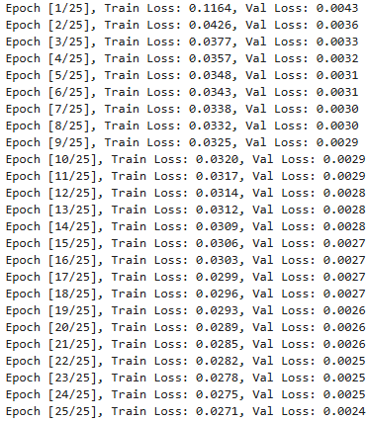
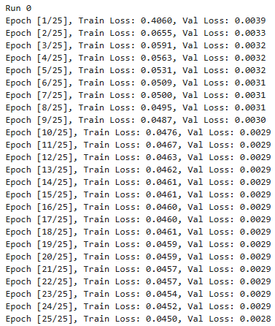
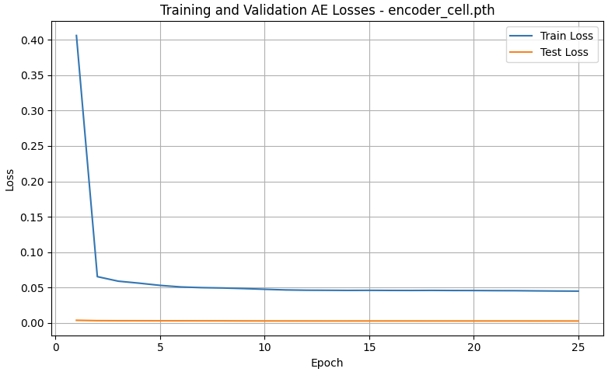
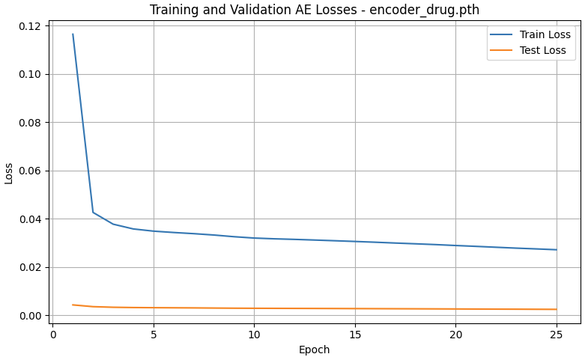
Train : CTRP-GDSC
Test : CCLE
Learning rate = 0.001
Weighted MSE, alpha = 10
Notes:
Weighted MSE is a variation of the standard Mean Squared Error that gives more importance to certain elements (non-zero here) in the reconstruction loss.
cell_mut and drug_finger contain mostly zeros, with a few rare but informative non-zero entries (1). If I use standard MSE, the model can:
Minimize the loss just by predicting zeros, since most entries are 0.
By using weighted MSE:
I force the AE to care about reconstructing non-zero entries, which often carry biologically or chemically meaningful information (e.g., mutations, active drug substructures).
The model can't "cheat" by just outputting zeros anymore.
But does not seem really beneficial… train loss and val loss min are higher than with MSE

Slide 17
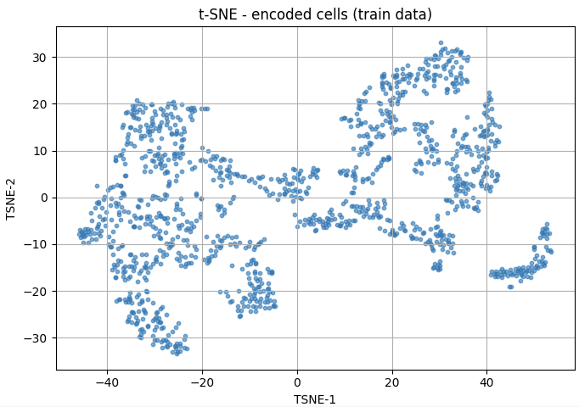
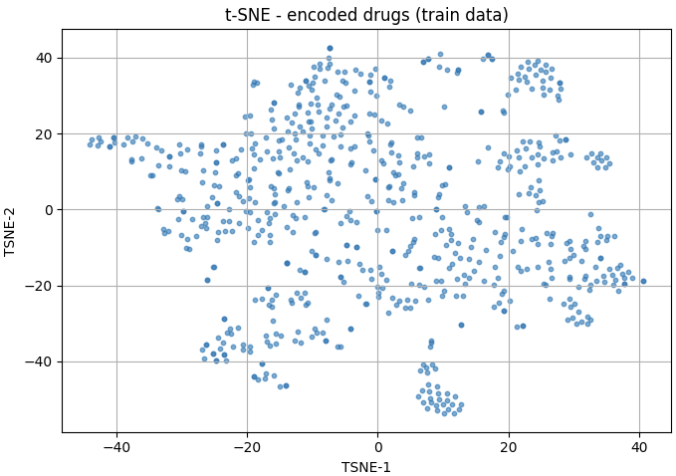
Train : CTRP-GDSC
Test : CCLE
Learning rate = 0.001
Weighted MSE, alpha = 10
z_cell std: 0.7913793921470642 z_drug std: 0.7871668338775635
Notes:
Std dev are smaller than with normal MSE
To try:  A hybrid loss (normal MSE + weighted MSE)
❐ a pretraining with α = 1, followed by a finetuning with α = 10

Slide 18
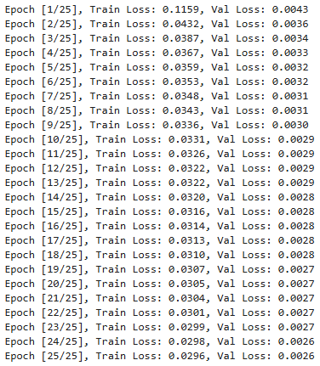
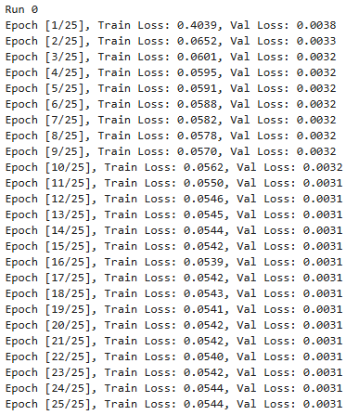
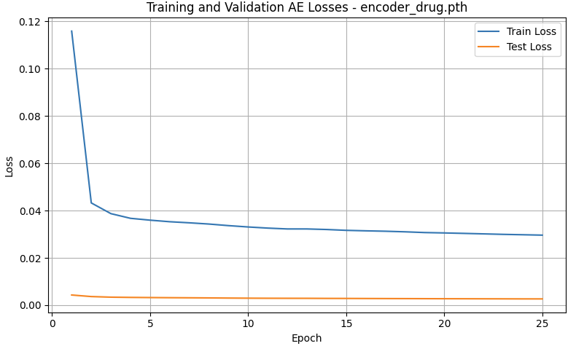
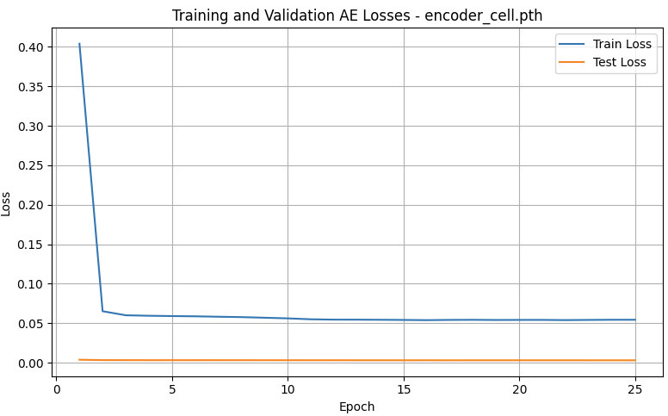
Train : CTRP-GDSC
Test : CCLE
Learning rate = 0.001
Weighted MSE, alpha = 10
Dropout regularization 0.2
Notes:
Le dropout est une technique de régularisation utilisée dans les réseaux de neurones pour éviter le surapprentissage (overfitting). Elle consiste à "éteindre" aléatoirement un certain pourcentage de neurones d’un réseau pendant chaque itération d'entraînement, forçant le réseau à ne pas trop dépendre de certains neurones et à apprendre des représentations plus robustes et généralisables.
Does not seem to change much than without Dropout regularization.

Slide 19
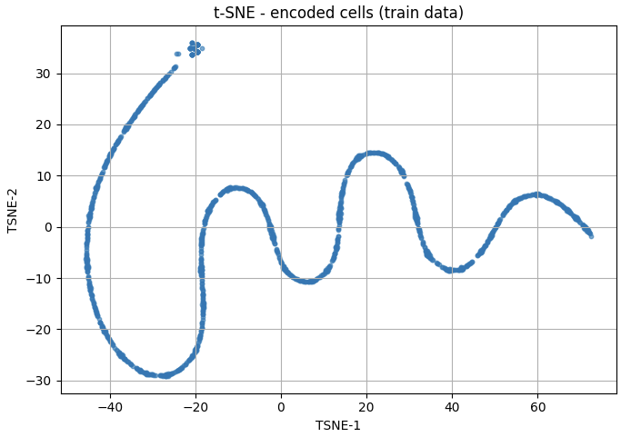
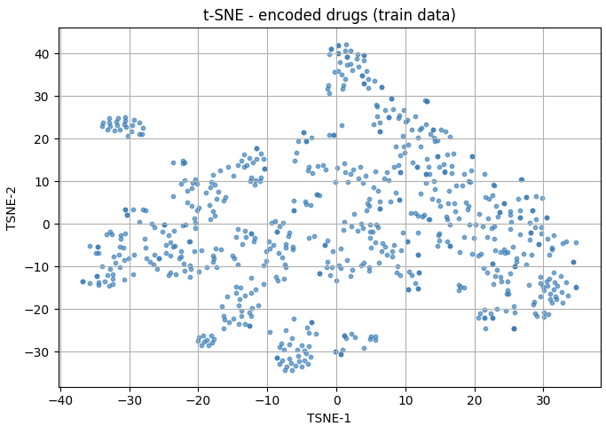
Train : CTRP-GDSC
Test : CCLE
Learning rate = 0.001
Weighted MSE, alpha = 10
Dropout regularization 0.2
Sparsity
z_cell: 0.0000, z_drug: 0.0000
z_cell std: 0.579213559627533 z_drug std: 0.4534982442855835
Notes:
Z_cell too compressed !!
Cette forme très régulière est aussi typiquement liée à une forme d’"effondrement de l’espace latent“
Peut être provoquée par :
un dropout trop fort (empêche d’exploiter toute l’info),
un alpha de weighted MSE trop élevé → l’AE focus presque uniquement sur les valeurs ≠ 0,
aucune contrainte de diversité (pas de pénalité sur les activations latentes).

Slide 20
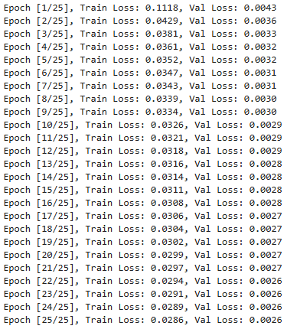
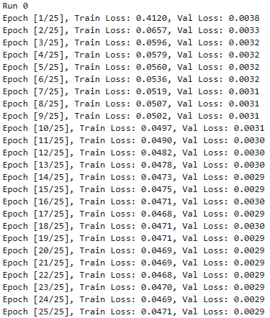
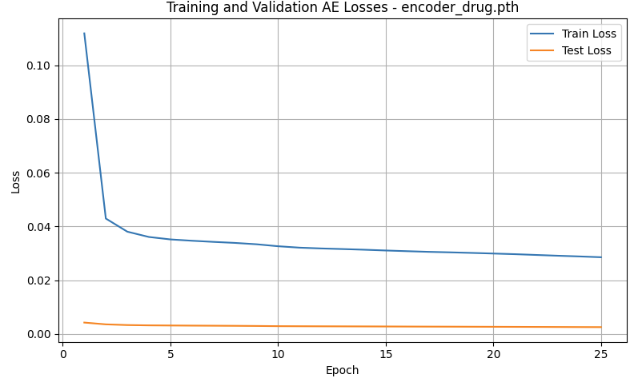
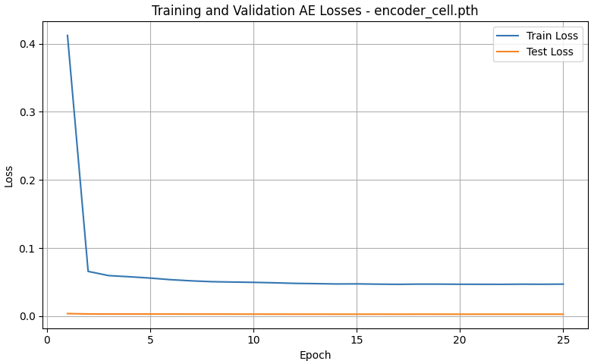
Train : CTRP-GDSC
Test : CCLE
Learning rate = 0.001
Weighted MSE, alpha = 10
Dropout regularization 0.05
Notes:
Dropout de 0.05 = seulement 5 % désactivés → régularisation plus faible.
Réduction du dropout → amélioration de la reconstruction, car moins de bruit injecté.
Train Loss descend plus rapidement et plus bas.
Validation Loss suit bien → pas de signe clair d'overfitting ici.
L’écart entre train et val est réduit, ce qui est bon.

Slide 21
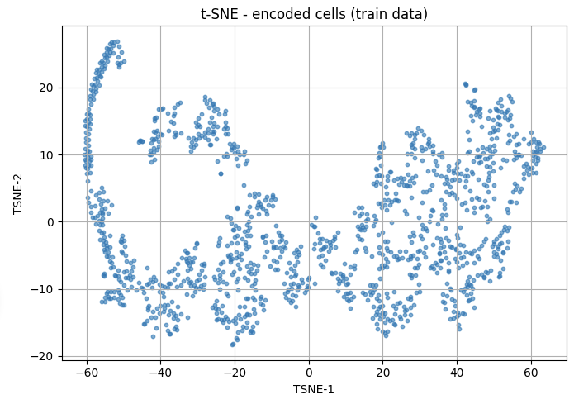
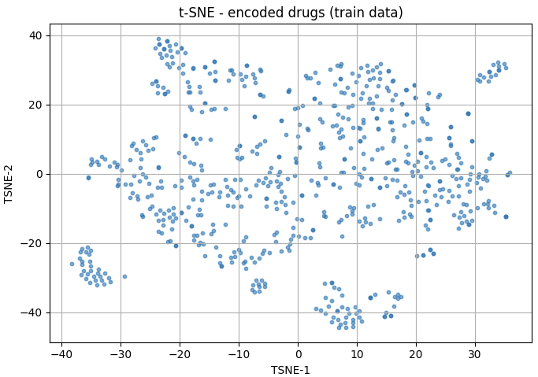
Train : CTRP-GDSC
Test : CCLE
Learning rate = 0.001
Weighted MSE, alpha = 10
Dropout regularization 0.05
Sparsity
z_cell: 0.0000, z_drug: 0.0000
z_cell std: 0.5146093964576721 z_drug std: 0.6292429566383362
Notes:
Avec dropout = 0.05 : beaucoup plus de richesse structurelle et de dispersion, on voit émerger des groupes distincts → la représentation latente est plus informative.
❐ Try dropout of 0.1 ?

Slide 22
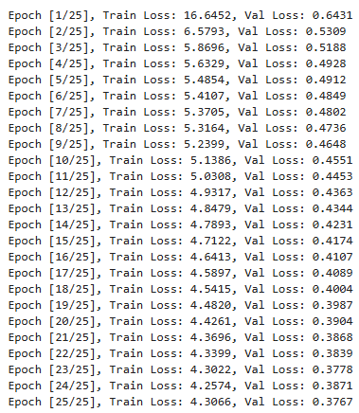



Train : CTRP-GDSC
Test : CCLE
Learning rate = 0.001
Weighted MSE, alpha = 10
Dropout regularization 0.05
# no normalization of tensors
Notes:
Train and val loss higher with no normalization of tensors
With normalization of tensors:
Stabilité numérique accrue : la normalisation supplémentaire réduit l’amplitude d’entrée, ce qui aide l’optimiseur à converger plus rapidement.
Perte de reconstruction plus basse sur le training et la validation, ce qui indique un meilleur encodage.

Slide 23


Train : CTRP-GDSC
Test : CCLE
Learning rate = 0.001
Weighted MSE, alpha = 10
Dropout regularization 0.05
# no normalization of tensors
❗ Attention : concatenation z_cell + z_drug pour un MLP: leurs échelles doivent être comparables (même std) sinon l’un dominera l’autre.
z_cell std: 0.6437125205993652 z_drug std: 0.7740590572357178
Notes:
Meilleure distribution légérement

Slide 24




Train : CTRP-GDSC
Test : CCLE
Learning rate = 0.001
Weighted MSE, alpha = 5
Dropout regularization 0.05
# no normalization of tensors
Notes:
Cell Autoencoder
alpha = 5 :
Val Loss atteint 0.0833
Train Loss converge autour de 1.89
alpha = 10 :
Val Loss autour de 0.15
Train Loss vers 3.16
→ Réduction significative de la loss de validation → bon indicateur de reconstruction plus fidèle.
Drug Autoencoder
alpha = 5 :
Val Loss ≈ 0.285
alpha = 10 :
Val Loss ≈ 0.376
→ Encore une fois, alpha = 5 donne une meilleure reconstruction.

Slide 25


Train : CTRP-GDSC
Test : CCLE
Learning rate = 0.001
Weighted MSE, alpha = 5
Dropout regularization 0.05
# no normalization of tensors
z_cell std: 0.5852428078651428 z_drug std: 0.781315803527832

Slide 26




Train : CTRP-GDSC
Test : CCLE
Learning rate = 0.001
Weighted MSE, alpha = 5
Dropout regularization 0.05
# no normalization of tensors
Cell latent_dim = 100
Drug latent_dim = 25
Notes:
AE cells:
Avec latent_dim 100/25 : Train Loss passe de 12.07 → 1.96, et Val Loss de 0.116 → 0.086.
Avec latent_dim 50/50 : Train Loss passe de 19.06 → 1.89, et Val Loss de 0.131 → 0.083.
AE drugs :
Avec latent_dim 100/25 : Train Loss passe de 9.19 → 3.24, et Val Loss de 0.46 → 0.28.
Avec latent_dim 50/50 : Train Loss passe de 9.27 → 3.02, et Val Loss de 0.45 → 0.26.
Ne semble pas changer grand chose

Slide 27


Train : CTRP-GDSC
Test : CCLE
Learning rate = 0.001
Weighted MSE, alpha = 5
Dropout regularization 0.05
# no normalization of tensors
Cell latent_dim = 100
Drug latent_dim = 25
z_cell std: 0.6258597373962402 z_drug std: 0.7381967902183533
Notes:
Espace latent cells légérement meilleur ?

Slide 28




Train : CTRP-GDSC
Test : CCLE
Learning rate = 0.001
Weighted MSE, alpha = 5
Dropout regularization 0.05
normalization of tensors
Cell latent_dim = 100
Drug latent_dim = 25
Notes:
AE cells:
Avec normalization des tenseurs : Train Loss passe de 0.16 → 0.02 et Val Loss de 0.002 → 0.0017.
Sans normalization des tenseurs : Train Loss passe de 12.07 → 1.96 et Val Loss de 0.116 → 0.086.
AE drugs :
Avec normalization des tenseurs : Train Loss passe de 0.07 → 0.02 et Val Loss de 0.003 → 0.0019.
Sans normalization des tenseurs : Train Loss passe de 9.19 → 3.24 et Val Loss de 0.46 → 0.28.
Train and val loss higher with no normalization of tensors

Slide 29


Train : CTRP-GDSC
Test : CCLE
Learning rate = 0.001
Weighted MSE, alpha = 5
Dropout regularization 0.05
normalization of tensors
Cell latent_dim = 100
Drug latent_dim = 25
z_cell std: 0.2563766837120056 z_drug std: 0.9628911018371582
Notes:
Espace latent des cellules très mauvais

Slide 30




Train : CTRP-GDSC
Test : CCLE
Learning rate = 0.001
Weighted MSE, alpha = 5
No Dropout regularization normalization of tensors
Cell latent_dim = 100
Drug latent_dim = 25
Notes:
AE cells:
Avec dropout regularization 0.05 : Train Loss passe de 0.16 → 0.02 et Val Loss de 0.002 → 0.0017.
Sans dropout regularization : Train Loss passe de 0.16 → 0.02 et Val Loss de 0.002 → 0.0015.
AE drugs :
Avec dropout regularization 0.05 : Train Loss passe de 0.07 → 0.02 et Val Loss de 0.003 → 0.0019.
Sans dropout regularization : Train Loss passe de 0.07 → 0.02 et Val Loss de 0.003 → 0.0018.
Ne semble pas changer grand-chose…

Slide 31


Train : CTRP-GDSC
Test : CCLE
Learning rate = 0.001
Weighted MSE, alpha = 5
No Dropout regularization normalization of tensors
Cell latent_dim = 100
Drug latent_dim = 25
z_cell std: 0.7787152528762817 z_drug std: 1.5899173021316528
Notes:
Mais espace latent amélioré !

Slide 32




Train : CTRP-GDSC
Test : CCLE
Learning rate = 0.001
Weighted MSE, alpha = 5
Dropout regularization 0.01
normalization of tensors
Cell latent_dim = 100
Drug latent_dim = 25
Notes:
AE cells:
Sans dropout regularization : Train Loss passe de 0.16 → 0.02 et Val Loss de 0.002 → 0.0015.
Avec dropout regularization de 0.01 : Train Loss passe de 0.16 → 0.02 et Val Loss de 0.002 → 0.0015.
Avec dropout regularization de 0.05 : Train Loss passe de 0.16 → 0.02 et Val Loss de 0.002 → 0.0017.
AE drugs :
Sans dropout regularization : Train Loss passe de 0.07 → 0.02 et Val Loss de 0.003 → 0.0018.
Avec dropout regularization de 0.01 : Train Loss passe de 0.07 → 0.02 et Val Loss de 0.003 → 0.0019.
Avec dropout regularization de 0.05 : Train Loss passe de 0.07 → 0.02 et Val Loss de 0.003 → 0.0019.
Ne change pas grand chose

Slide 33


Train : CTRP-GDSC
Test : CCLE
Learning rate = 0.001
Weighted MSE, alpha = 5
Dropout regularization 0.01
normalization of tensors
Cell latent_dim = 100
Drug latent_dim = 25
z_cell std: 0.5191094279289246 z_drug std: 1.1648218631744385

Slide 34




Train : CTRP-GDSC
Test : CCLE
Learning rate = 0.001
Weighted MSE, alpha = 5
No Dropout regularization
normalization of tensors
Cell latent_dim = 1000
Drug latent_dim = 50
Notes:
AE cells:
Cell latent dim 1000 : Train Loss passe de 0.17 → 0.03 et Val Loss de 0.005 → 0.0018.
Cell latent_dim 100 : Train Loss passe de 0.16 → 0.02 et Val Loss de 0.002 → 0.0015.
AE drugs:
Drug latent dim 50 : Train Loss passe de 0.07 → 0.019 et Val Loss de 0.003 → 0.0017.
Drug latent dim 25 : Train Loss passe de 0.07 → 0.02 et Val Loss de 0.003 → 0.0018.

Slide 35


Train : CTRP-GDSC
Test : CCLE
Learning rate = 0.001
Weighted MSE, alpha = 5
No Dropout regularization
normalization of tensors
Cell latent_dim = 1000
Drug latent_dim = 50
z_cell std: 8.51994514465332 z_drug std: 1.157694935798645

Slide 36




Train : CTRP-GDSC
Test : CCLE
Learning rate = 0.001
Weighted MSE, alpha = 5
No Dropout regularization
normalization of tensors
Cell latent_dim = 700
Drug latent_dim = 50
Notes:
AE cells:
Cell latent dim 1000 : Train Loss passe de 0.17 → 0.03 et Val Loss de 0.005 → 0.0018.
Cell latent_dim 700 : Train Loss passe de 0.16 → 0.028 et Val Loss de 0.004 → 0.0017.
AE drugs:
Drug latent dim 50 : Train Loss passe de 0.07 → 0.019 et Val Loss de 0.003 → 0.0018.
Drug latent dim 25 : Train Loss passe de 0.07 → 0.02 et Val Loss de 0.003 → 0.0018.

Slide 37


Train : CTRP-GDSC
Test : CCLE
Learning rate = 0.001
Weighted MSE, alpha = 5
No Dropout regularization
normalization of tensors
Cell latent_dim = 700
Drug latent_dim = 50
z_cell std: 3.8540782928466797 z_drug std: 1.2107963562011719

Slide 38




Train : CTRP-GDSC
Test : CCLE
Learning rate = 0.001
Weighted MSE, alpha = 5
No Dropout regularization
normalization of tensors
Cell latent_dim = 500
Drug latent_dim = 50
Notes:
AE cells:
Cell latent dim 1000 : Train Loss passe de 0.17 → 0.03 et Val Loss de 0.005 → 0.0018.
Cell latent_dim 700 : Train Loss passe de 0.16 → 0.028 et Val Loss de 0.004 → 0.0017.
Cell latent_dim 500 : Train Loss passe de 0.129 → 0.025 et Val Loss de 0.002 → 0.0016.

Slide 39


Train : CTRP-GDSC
Test : CCLE
Learning rate = 0.001
Weighted MSE, alpha = 5
No Dropout regularization
normalization of tensors
Cell latent_dim = 500
Drug latent_dim = 50
z_cell std: 1.7959409952163696 z_drug std: 1.0577332973480225

Slide 40




Train : CTRP-GDSC
Test : CCLE
Learning rate = 0.001
Weighted MSE, alpha = 3
No Dropout regularization
normalization of tensors
Cell latent_dim = 700
Drug latent_dim = 50
Notes:
AE cells:
Alpha = 5 : Train Loss passe de 0.16 → 0.028 et Val Loss de 0.004 → 0.0017.
Alpha = 3 : Train Loss passe de 0.098 → 0.018 et Val Loss de 0.0029 → 0.0010.
AE drugs:
Alpha = 5 : Train Loss passe de 0.07 → 0.019 et Val Loss de 0.003 → 0.0018.
Alpha = 3 : Train Loss passe de 0.04 → 0.014 et Val Loss de 0.002 → 0.0013.
Alpha = 3 Semble mieux

Slide 41


Train : CTRP-GDSC
Test : CCLE
Learning rate = 0.001
Weighted MSE, alpha = 3
No Dropout regularization
normalization of tensors
Cell latent_dim = 700
Drug latent_dim = 50
z_cell std: 5.033831596374512 z_drug std: 1.2838635444641113

Slide 42




Train : CTRP-GDSC
Test : CCLE
Learning rate = 0.001
Weighted MSE, alpha = 3
Dropout regularization 0.1
normalization of tensors
Cell latent_dim = 700
Drug latent_dim = 50
Notes:
AE cells:
Sans Dropout regularization : Train Loss passe de 0.098 → 0.018 et Val Loss de 0.0029 → 0.0010.
With Dropout regularization 0.1 : Train Loss passe de 0.099 → 0.018 et Val Loss de 0.0029 → 0.0010.
AE drugs:
Sans Dropout regularization : Train Loss passe de 0.04 → 0.014 et Val Loss de 0.002 → 0.0013.
With Dropout regularization 0.1 : Train Loss passe de 0.04 → 0.015 et Val Loss de 0.002 → 0.0014.
Ne semble pas changer grand chose

Slide 43


Train : CTRP-GDSC
Test : CCLE
Learning rate = 0.001
Weighted MSE, alpha = 3
Dropout regularization 0.1
normalization of tensors
Cell latent_dim = 700
Drug latent_dim = 50
z_cell std: 1.8434468507766724 z_drug std: 0.8110901117324829

Slide 44
Train : CTRP-GDSC
Test : CCLE
Learning rate = 0.001
Weighted MSE, alpha = 3
No dropout
normalization of tensors
Cell latent_dim = 700
Drug latent_dim = 50
Notes:
AE cells:
Sans Dropout regularization : Train Loss passe de 0.098 → 0.018 et Val Loss de 0.0029 → 0.0010.
With Dropout regularization 0.1 : Train Loss passe de 0.099 → 0.018 et Val Loss de 0.0029 → 0.0010.
AE drugs:
Sans Dropout regularization : Train Loss passe de 0.04 → 0.014 et Val Loss de 0.002 → 0.0013.
With Dropout regularization 0.1 : Train Loss passe de 0.04 → 0.015 et Val Loss de 0.002 → 0.0014.
Ne semble pas changer grand chose

Slide 45
Train : CTRP-GDSC
Test : CCLE
Learning rate = 0.001
Weighted MSE, alpha = 3
Dropout regularization 0.1
normalization of tensors
Cell latent_dim = 700
Drug latent_dim = 50
z_cell std: 1.8434468507766724 z_drug std: 0.8110901117324829

Slide 46



Learning rate = 0.001
Weighted MSE, alpha = 5
Dropout regularization 0.05
# no normalization of tensors
Cell latent_dim = 100
Drug latent_dim = 25

Slide 47



Learning rate = 0.001
Weighted MSE, alpha = 5
Dropout regularization 0.05
# no normalization of tensors
Cell latent_dim = 100
Drug latent_dim = 25
AVG Accuracy | 0.822
AVG Precision | 0.843
AVG Recall | 0.839
AVG F1 score | 0.840
AVG AUC | 0.900
AVG AUPRC | 0.903
Std AUPRC | 0.007

Slide 48

Train : CTRP-GDSC
Test : CCLE
Learning rate = 0.001
Weighted MSE, alpha = 1
Dropout regularization 0.05
# no normalization of tensors
Cell latent_dim = 100
Drug latent_dim = 25

Slide 49


Train : CTRP-GDSC
Test : CCLE
Learning rate = 0.001
Weighted MSE, alpha = 1
Dropout regularization 0.05
# no normalization of tensors
Cell latent_dim = 100
Drug latent_dim = 25
Sparsity
z_cell: 0.0000, z_drug: 0.0000
z_cell std: 0.6258597373962402 z_drug std: 0.7381967902183533

Slide 50



Learning rate = 0.001
Weighted MSE, alpha = 1
Dropout regularization 0.05
# no normalization of tensors
Cell latent_dim = 100
Drug latent_dim = 25

Slide 51



Learning rate = 0.001
Weighted MSE, alpha = 1
Dropout regularization 0.05
# no normalization of tensors
Cell latent_dim = 100
Drug latent_dim = 25
AVG Accuracy | 0.784
AVG Precision | 0.768
AVG Recall | 0.833
AVG F1 score | 0.799
AVG AUC | 0.850
AVG AUPRC | 0.820
Std AUPRC | 0.013

Slide 52




Train : CTRP-GDSC
Test : CCLE
Learning rate = 0.001
Weighted MSE, alpha = 1
Dropout regularization 0.05
# no normalization of tensors
Cell latent_dim = 100
Drug latent_dim = 25
Without cell_mut modality

Slide 53


Train : CTRP-GDSC
Test : CCLE
Learning rate = 0.001
Weighted MSE, alpha = 1
Dropout regularization 0.05
# no normalization of tensors
Cell latent_dim = 100
Drug latent_dim = 25
Without cell_mut modality
Sparsity
z_cell: 0.0000, z_drug: 0.0000
z_cell std: 0.5464912056922913 z_drug std: 0.7619394063949585

Slide 54



Learning rate = 0.001
Weighted MSE, alpha = 1
Dropout regularization 0.05
# no normalization of tensors
Cell latent_dim = 100
Drug latent_dim = 25
Without cell_mut modality

Slide 55



Learning rate = 0.001
Weighted MSE, alpha = 1
Dropout regularization 0.05
# no normalization of tensors
Cell latent_dim = 100
Drug latent_dim = 25
Without cell_mut modality
AVG Accuracy | 0.807
AVG Precision | 0.894
AVG Recall | 0.791
AVG F1 score | 0.839
AVG AUC | 0.881
AVG AUPRC | 0.874
Std AUPRC | 0.011
Notes:
Better without cell_mut modality

Slide 56




MSE - lr = 0.01
CTRP-GDSC

Slide 57




MSE - lr = 0.01
CTRP-GDSC
Sparsity z_cell: 0.4600,
z_drug: 0.5800
AVG Accuracy | ~50%

Slide 58




MSE weighted alpha 1 - lr = 0.01
CTRP-GDSC
AVG Accuracy | 0.683
AVG Precision | 0.717
AVG Recall | 0.687
AVG F1 score | 0.701
AVG AUC | 0.749
AVG AUPRC | 0.740
Std AUPRC | 0.009

Slide 59




MSE weighted alpha 1 - lr = 0.01
CTRP-GDSC
Sparsity z_cell: 0.5175,
z_drug: 0.5225
AVG Accuracy | 0.683
AVG Precision | 0.717
AVG Recall | 0.687
AVG F1 score | 0.701
AVG AUC | 0.749
AVG AUPRC | 0.740
Std AUPRC | 0.009

Slide 60




MSE weighted alpha 1 - lr = 0.001

Slide 61




MSE weighted alpha 1 - lr = 0.001
Sparsity z_cell: 0.5154,
z_drug: 0.4016
AVG Accuracy | 0.905
AVG Precision | 0.944
AVG Recall | 0.881
AVG F1 score | 0.911
AVG AUC | 0.969
AVG AUPRC | 0.965
Std AUPRC | 0.011

Slide 62






AE PRETRAINING WITH ALL DATA - WEIGHTED MSE - Encoders NOT FROZEN during MLP training (sans la couche ReLu de sortie de l'encodeur)
Accuracy =0.70
AE PRETRAINING WITH ALL DATA - WEIGHTED MSE - Encoders FROZEN during MLP training (sans la couche ReLu de sortie de l'encodeur)
Accuracy = 0.52

